Slide 1

A Diagnostic Marker to Discriminate Childhood Apraxia of Speech (CAS) from Speech Delay (SD): The Pause Marker
Phonology Project
Waisman Center
University of Wisconsin-Madison
Tilkens, C. M., Karlsson, H. B., Fourakis, M., Hall, S. D., Mabie, H. L., McSweeny, J. L., Wilson, D., & Shriberg, L. D. [2017]. A diagnostic marker to Discriminate Childhood Apraxia of Speech (CAS) from Speech Delay (SD): The Pause Marker [Tech. Rep. No. 22]

Slide 2
A Diagnostic Marker to Discriminate Childhood Apraxia of Speech (CAS) from Speech Delay (SD): The Pause Marker
PART III. SPECTROGRAPHIC EXEMPLARS FOR THE FOUR
TYPE I AND TYPE II INAPPROPRIATE PAUSE TYPES
(To view the spectrographic display and play accompanying audio,
place cursor in the center of the display within slideshow view and click mouse).
Tilkens, C. M., Karlsson, H. B., Fourakis, M., Hall, S. D., Mabie, H. L., McSweeny, J. L., Wilson, D., & Shriberg, L. D. [2017]. A diagnostic marker to Discriminate Childhood Apraxia of Speech (CAS) from Speech Delay (SD): The Pause Marker [Tech. Rep. No. 22]

Slide 3
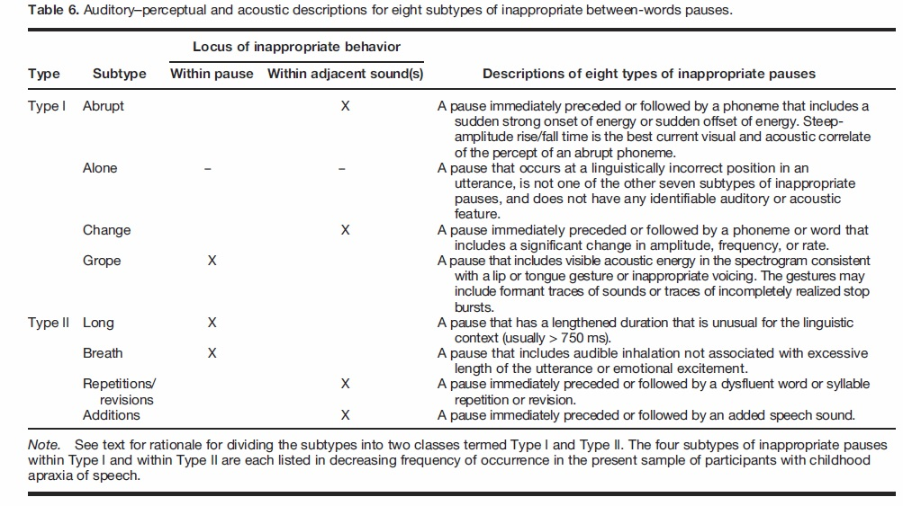
Shriberg, L. D., Strand, E. A., Fourakis, M., Jakielski, K. J., Hall, S. D., Karlsson, H. B., Mabie, H. L., McSweeny, J. L., Tilkens, C. M., &
Wilson, D. L. (2017a). A diagnostic marker to Discriminate Childhood Apraxia of Speech from Speech Delay: I. Development and description of The Pause Marker. Journal of Speech, Language, and Hearing Research. Advance online publication. https://doi.org/10.1044/2016_JSLHR-S-15-0296

Slide 4
Contents
Type I Inappropriate Between-Words Pauses
A. Abrupt
1. abrupt_09: 7 year old male
2. abrupt_14: 10 year old male
3. abrupt_19: 6 year old male
4. abrupt_022: 12 year old female
5. abrupt_026: 7 year old male
6. abrupt_040: 4 year old male
7. abrupt_E03: 6 year old female
8. abruptchange_B03: 16 year old female
B. Alone
1. alone_10: 11 year old male
2. alone_032: 13 year old female
3. alone_046: 12 year old female
C. Change
1. change_14: 7 year old male
2. change_053: 7 year old male
3. change2_14: 10 year old male
D. Grope
1. grope_18: 15 year old male
2. grope_049: 70 year old male
3. grope_053: 7 year old male

Slide 5
Contents
II. Type II Inappropriate Between-Words Pauses
A. Long
1. long_10: 11 year old male
2. long_023: 12 year old female
B. Breath
1. breath_032: 5 year old male
2. breath_045: 5 year old male
C. Repetitions/Revisions
1. repeatrevise_023: 12 year old female
2. repeatrevise_026: 7 year old male
D. Additions
1. addition_023: 12 year old female

Slide 6
Contents
III. “Voicer” exemplar

Slide 7
Type I Inappropriate Between-Words Pauses
A. Abrupt

Slide 8
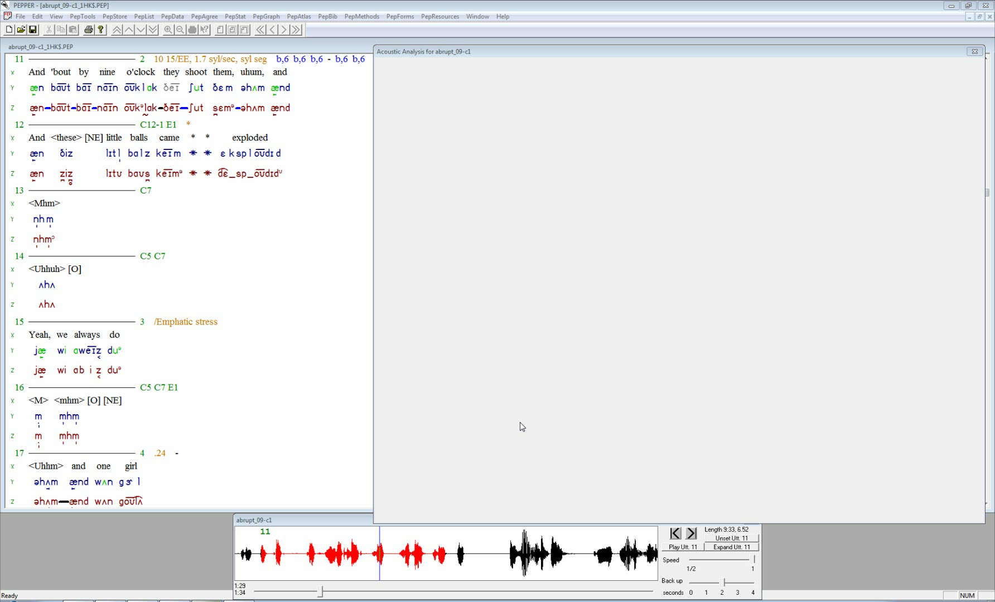
abrupt_09: 7 year old male. The utterance was glossed as: “And ‘bout by nine o’clock they shoot them, uhum, and”
There are several pauses in this utterance. All but one are inappropriate pauses in inappropriate linguistic units (lavender).
Each inappropriate pause was coded as abrupt. Note the halting nature of the utterance and sudden loud onsets following the inappropriate pauses.
The appropriate pause (blue) occurs between the words “o’clock” and “they.”
Vowels and selected consonants are marked in red.

Slide 9
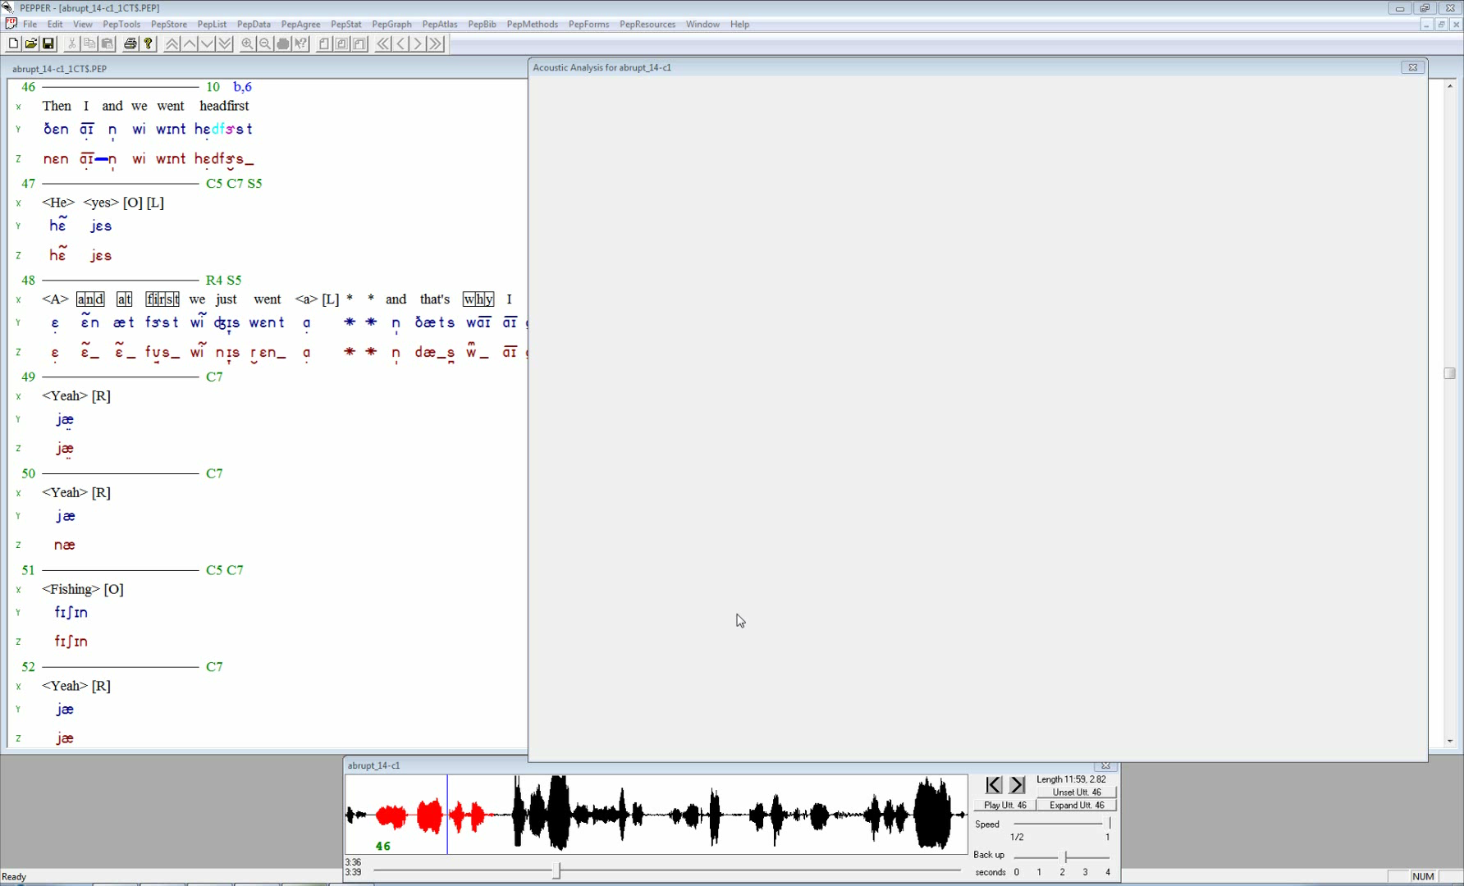
abrupt_14: 10 year old male. The utterance was glossed as: “Then I and we went headfirst”
There is one pause in this utterance, between “I” and “and.” It’s an inappropriate pause located in an inappropriate linguistic unit (lavender).
Note the abrupt onset of glottal pulsing for “and” following the inappropriate pause.
Vowels and select consonants are marked in red.

Slide 10
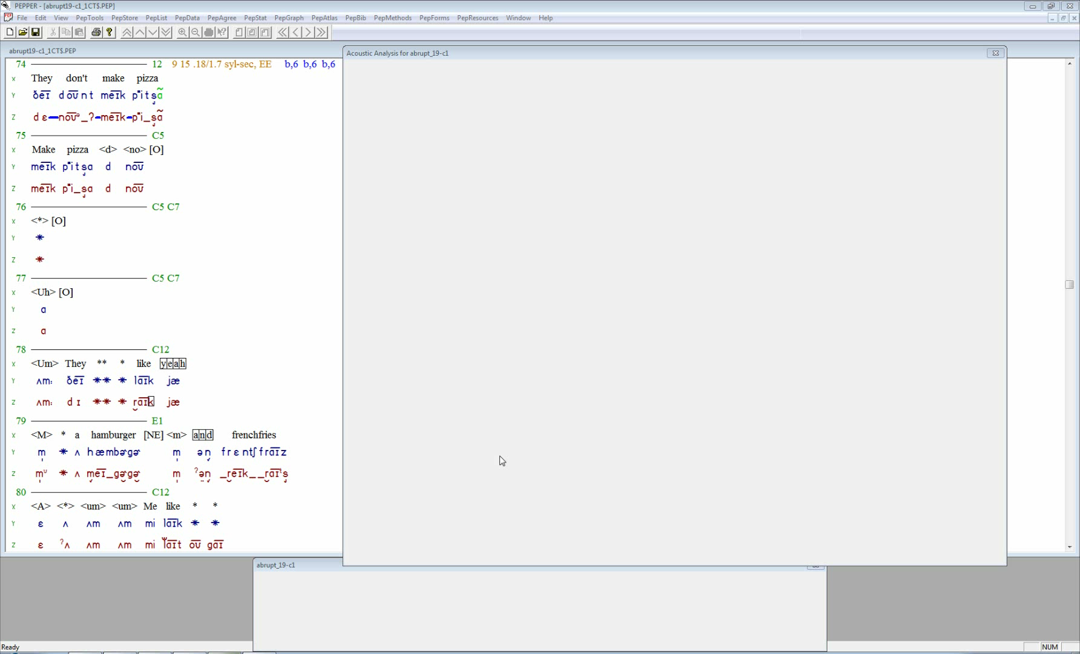
abrupt_19: 6 year old male. The utterance was glossed as: “They don’t make pizza”
There are 3 inappropriate pauses in inappropriate linguistic locations (marked lavender). Note the abrupt (sudden,loud) onset of each consonant following the inappropriate pauses.
Vowels and select consonants are marked in red.

Slide 11
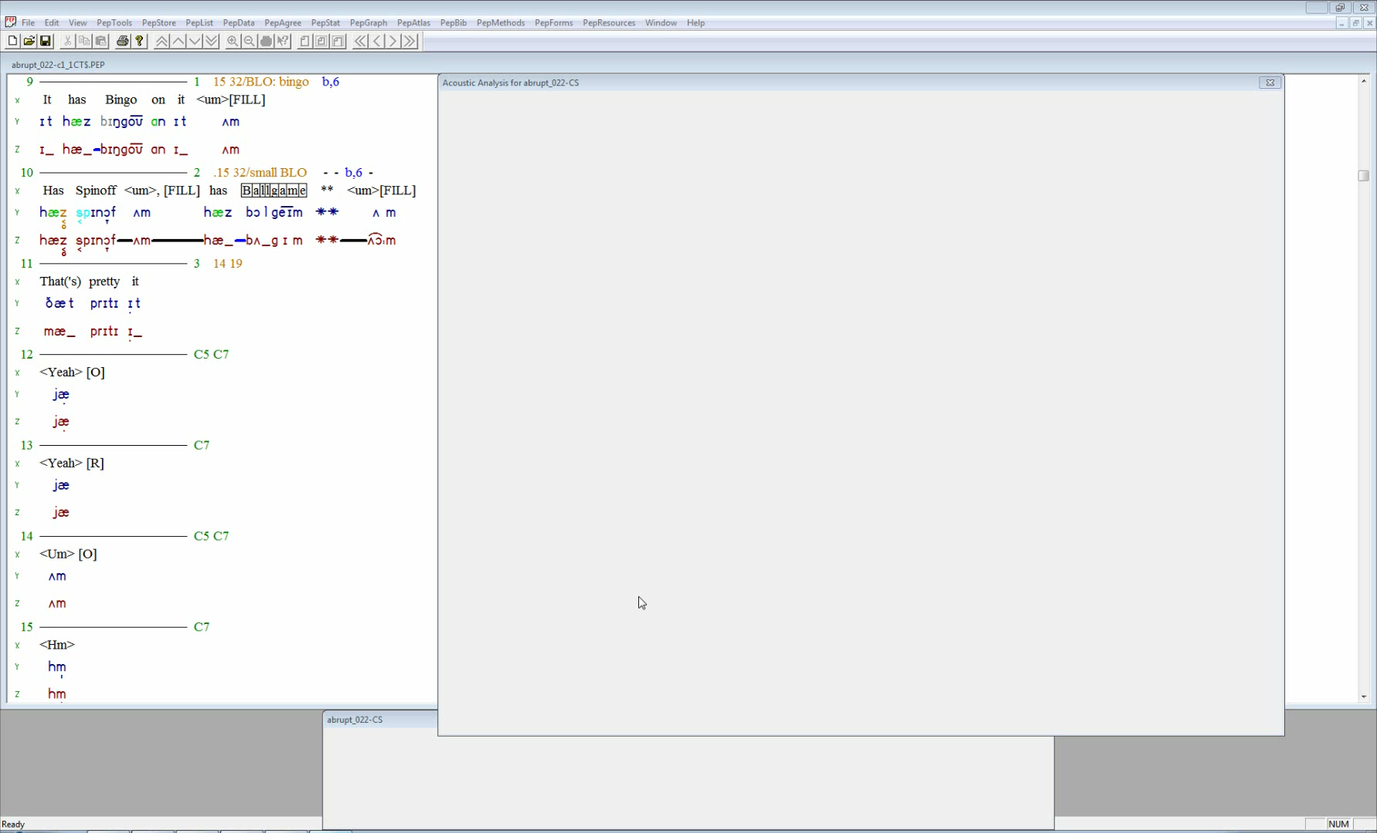
abrupt_022: 12 year old female. The utterance was glossed as: “It has Bingo on it, um”
There is one pause. It’s an inappropriate pause (lavender) between “has” and “Bingo” in an inappropriate linguistic unit.
Note the relatively sharp onset of the “b” in bingo as well as a slight over-emphasis of the first syllable in “bingo.”
Vowels and select consonants are marked in red.

Slide 12
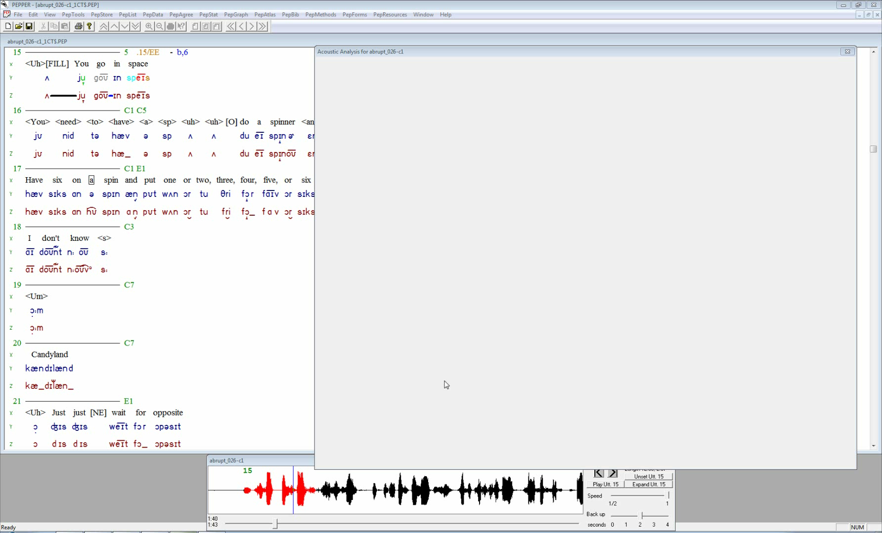
abrupt_026: 7 year old male. The utterance was glossed as: “Uh, you go in space”
There are two pauses in this utterance. The first (blue) follows “uh” and is an appropriate pause.
The second pause (lavender) is between the words “go” and “in” and is an inappropriate pause located in an inappropriate linguistic unit.
Note also the abrupt (sudden, loud) onset of glottal pulsing for “in” following the inappropriate pause.
Vowels and select consonants are marked in red.

Slide 13
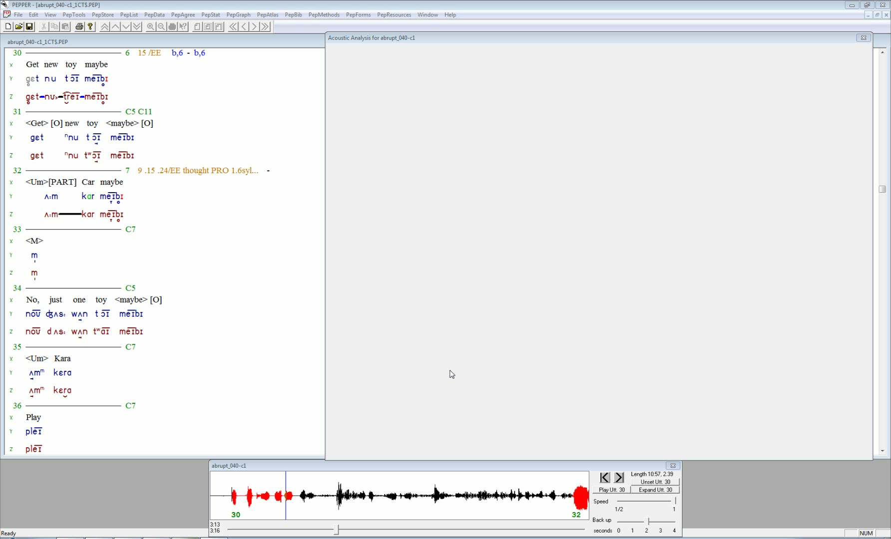
abrupt_040: 4 year old male. The utterance was glossed as: “Get new toy maybe”
There are three pauses in this utterance. The second pause (blue) is between the words “new” and “toy” and is an appropriate pause.
The other two pauses (lavender) are between the words “got” and “new” as well as “toy” and “maybe.”
They are both inappropriate pauses in inappropriate linguistic units.
Note the sudden onsets of both nasal sounds following the inappropriate pauses.
Vowels and select consonants are marked in red.

Slide 14
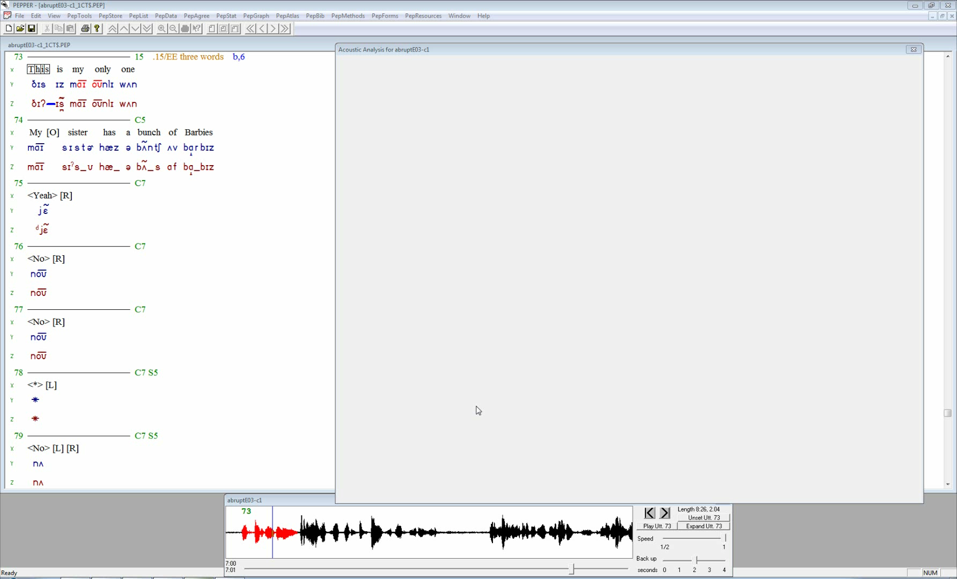
abrupt_E03: 6 year old female. The utterance was glossed as: “<This> is my only one”
There is one pause in this utterance. It’s an inappropriate pause in an inappropriate linguistic unit between “this” and “is.”
Note the abrupt (sudden loud) onset of glottal pulsing for “is” following the inappropriate pause.
Vowels and select consonants are marked in red.

Slide 15
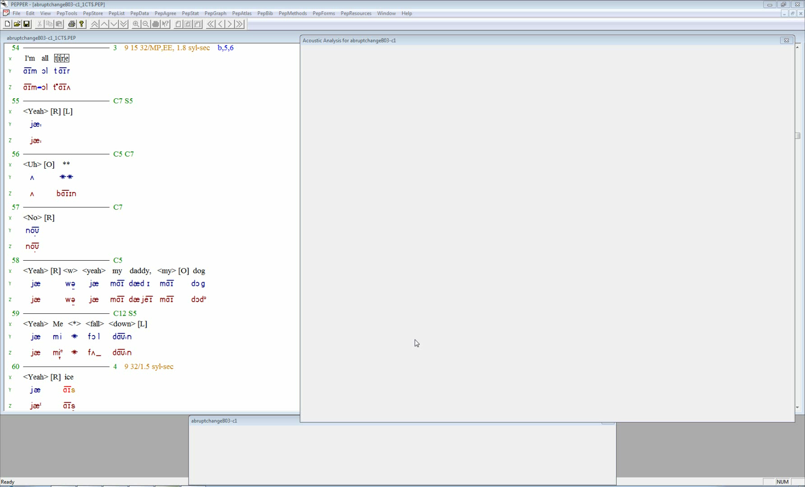
abruptchange_B03: 16 year old female. The utterance was glossed as: “I’m all <tire>”
There is one pause in this utterance. It is marked lavender and is between the words “I’m” and “all.”
Note the abrupt (sudden loud) onset of glottal pulsing for “all” as well as the relatively loud production of “all” following the inappropriate pause.
Vowels and select consonants are marked in red.

Slide 16
Type I Inappropriate Between-Words Pauses
B. Alone

Slide 17
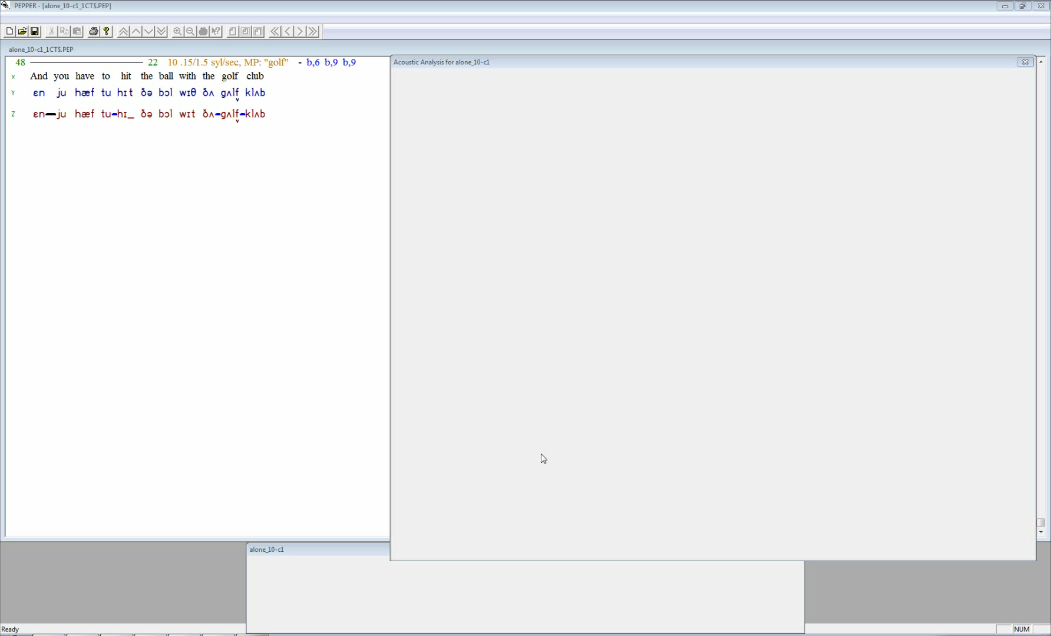
alone_10: 11 year old male. The utterance was glossed as: “And you have to hit the ball with the golf club”
There are 4 pauses in this utterance. The first (blue) is appropriate and is between the words “and” and “you.”
The second pause (lavender) is an abrupt pause.
The final two pauses between “the” and “golf” as well as “golf” and “club” are inappropriate pauses in inappropriate linguistic units, with no other notable characteristic that makes them inappropriate.
Vowels and select consonants are marked in red.

Slide 18
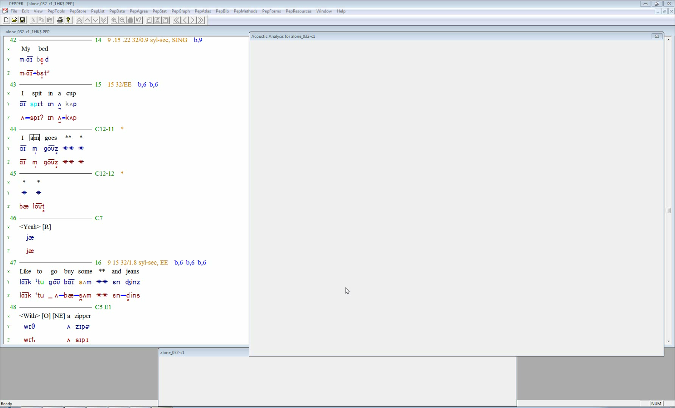
alone_032: 13 year old female. The utterance was glossed as: “My bed”
There is one pause in this utterance. It’s an inappropriate pause in an inappropriate linguistic unit (lavender) and is between the words “my” and “bed.”
There was no other notable characteristic making this pause inappropriate.
Vowels and select consonants are marked in red.

Slide 19
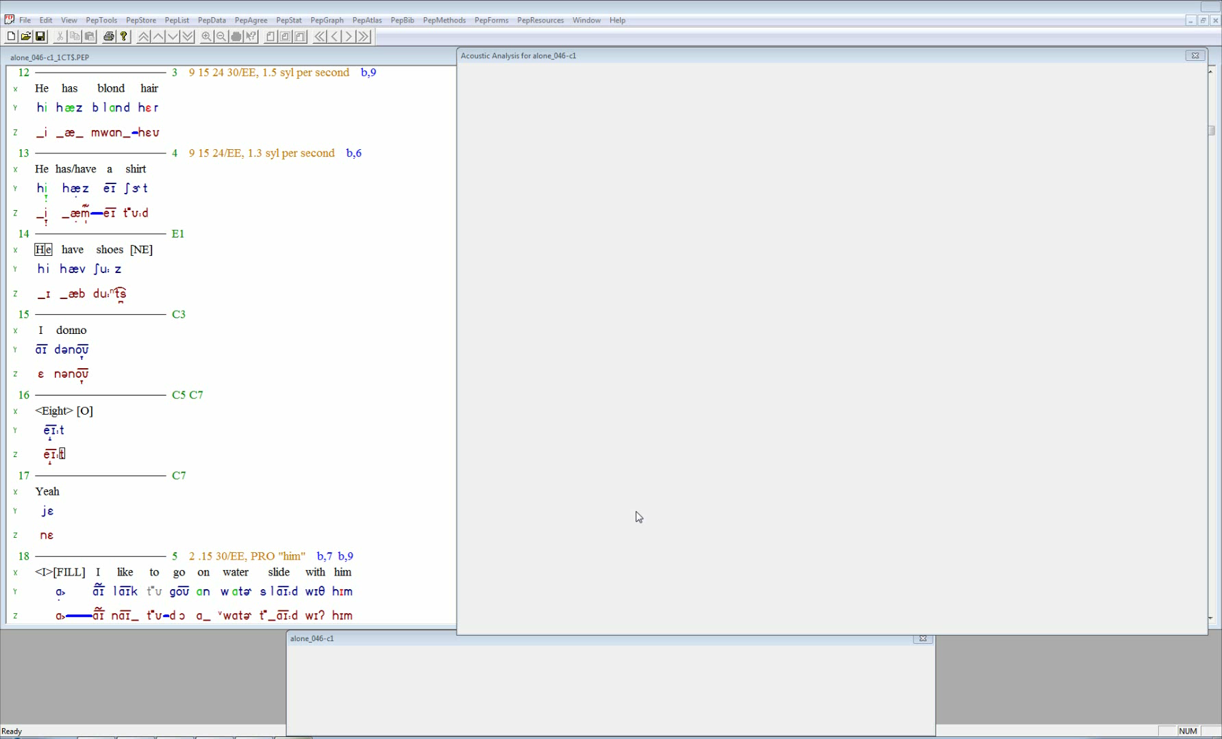
alone_046: 12 year old female. The utterance was glossed as: “He has blond hair”
There is one pause in this utterance. It’s an inappropriate pause in an inappropriate linguistic unit (lavender).
The pause is between “blond” and “hair.”
There was no other notable characteristic making this pause inappropriate.
Vowels and select consonants are marked in red.

Slide 20
Type I Inappropriate Between-Words Pauses
C. Change

Slide 21
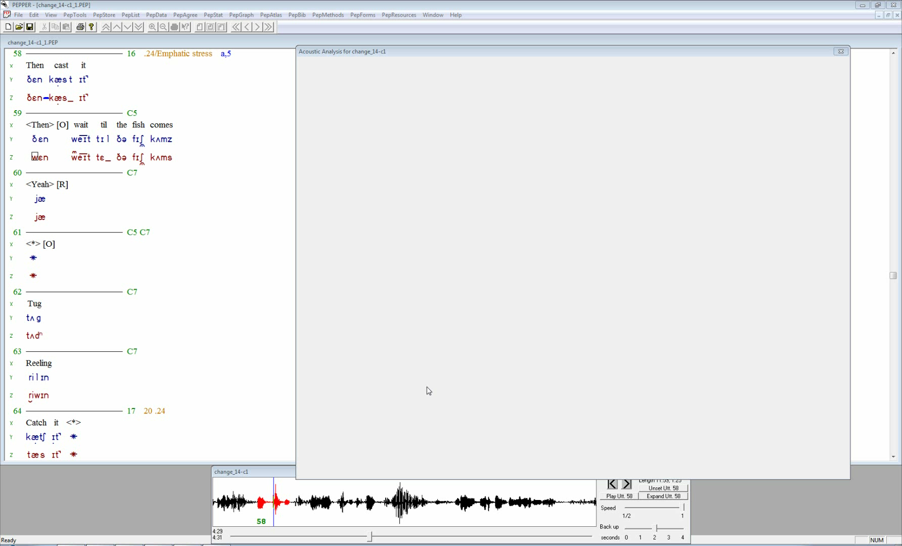
change_14: 7 year old male. The utterance was glossed as: “Then cast it”
There is one inappropriate pause (lavender) in an appropriate linguistic unit in this utterance.
It is between “then” and “cast.”
Note the change in amplitude for the initial consonant and vowel in “cast.”
Vowels and select consonants are marked in red.

Slide 22
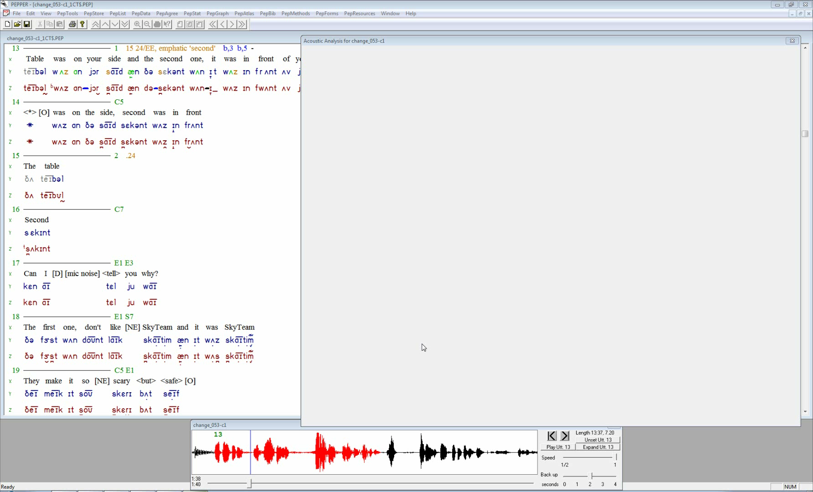
change_053: 7 year old male. The utterance was glossed as: “Table was on your side and the second one, it was in front of you”
There are three pauses in this utterance.
The first two are inappropriate pauses (lavender) in inappropriate linguistic units.
The first inappropriate pause has a breath; the second inappropriate pause between “the” and “second” has an amplitude change.
Note the loudness in the initial consonant and vowel for “second.” The last pause (blue) is appropriate.
Vowels and select consonants are marked in red.

Slide 23
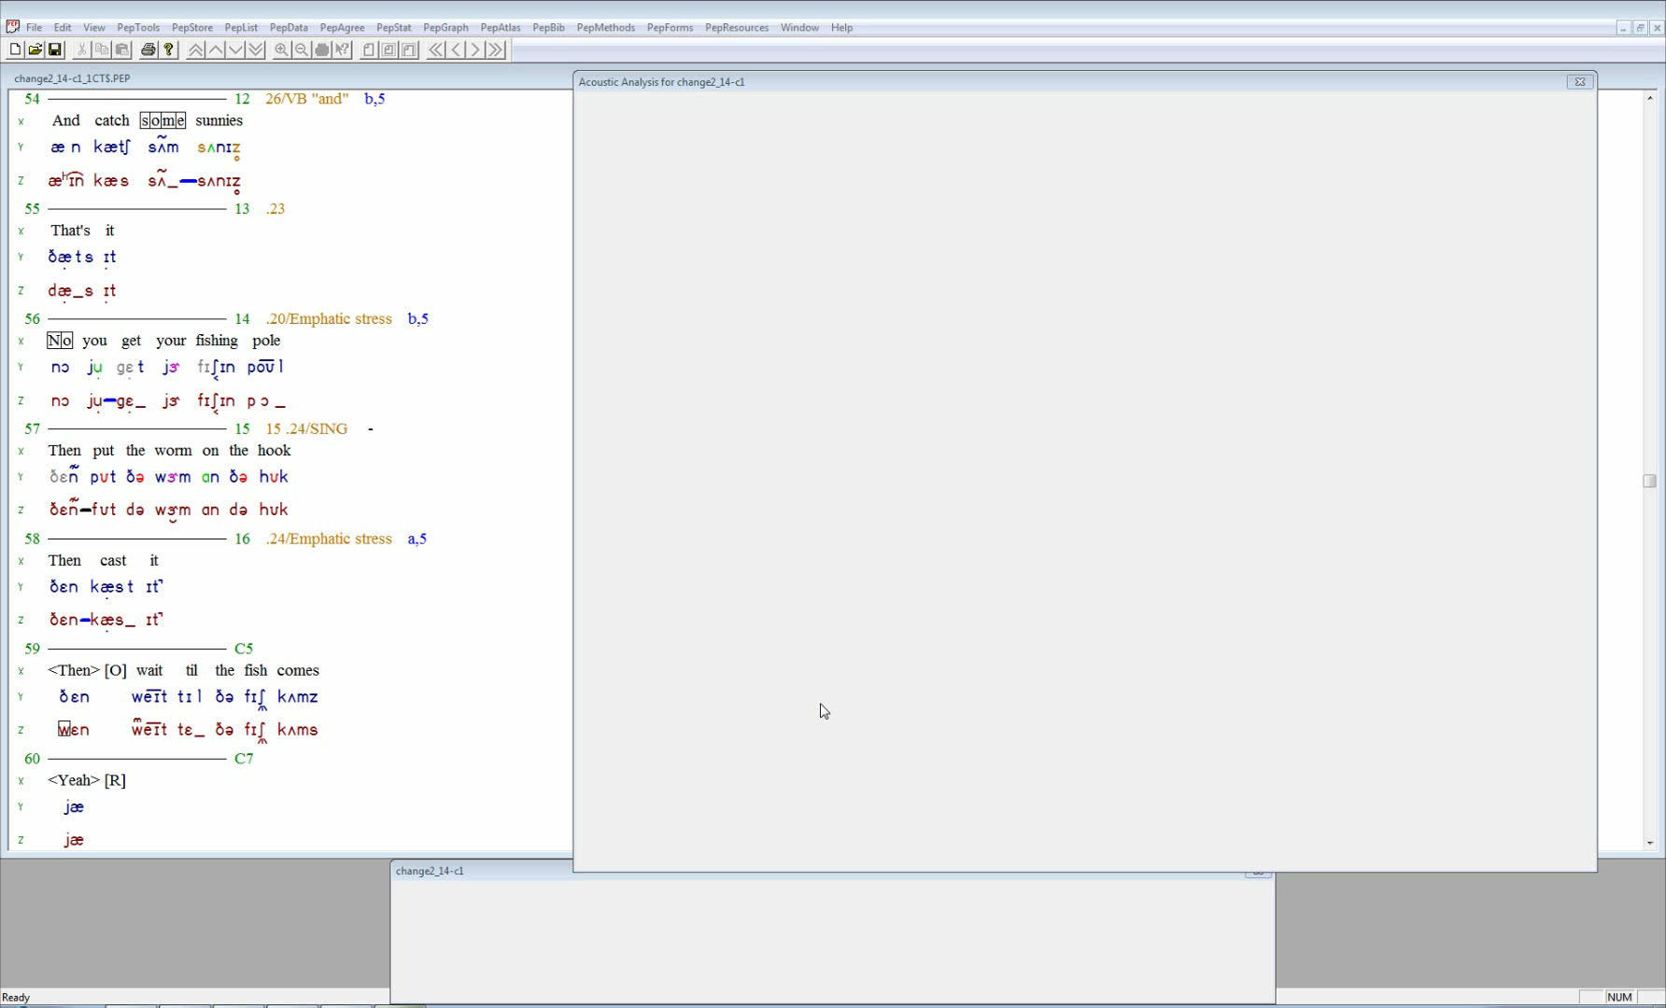
change2_14: 10 year old male. The utterance was glossed as: “And catch <some> sunnies”
There is one inappropriate pause (lavender) in an inappropriate linguistic unit in this utterance.
It’s between “some” and “sunnies.”
Note the increased amplitude in the initial consonant and vowel of “sunnies.”
Vowels and select consonants are marked in red.

Slide 24
Type I Inappropriate Between-Words Pauses
D. Grope

Slide 25
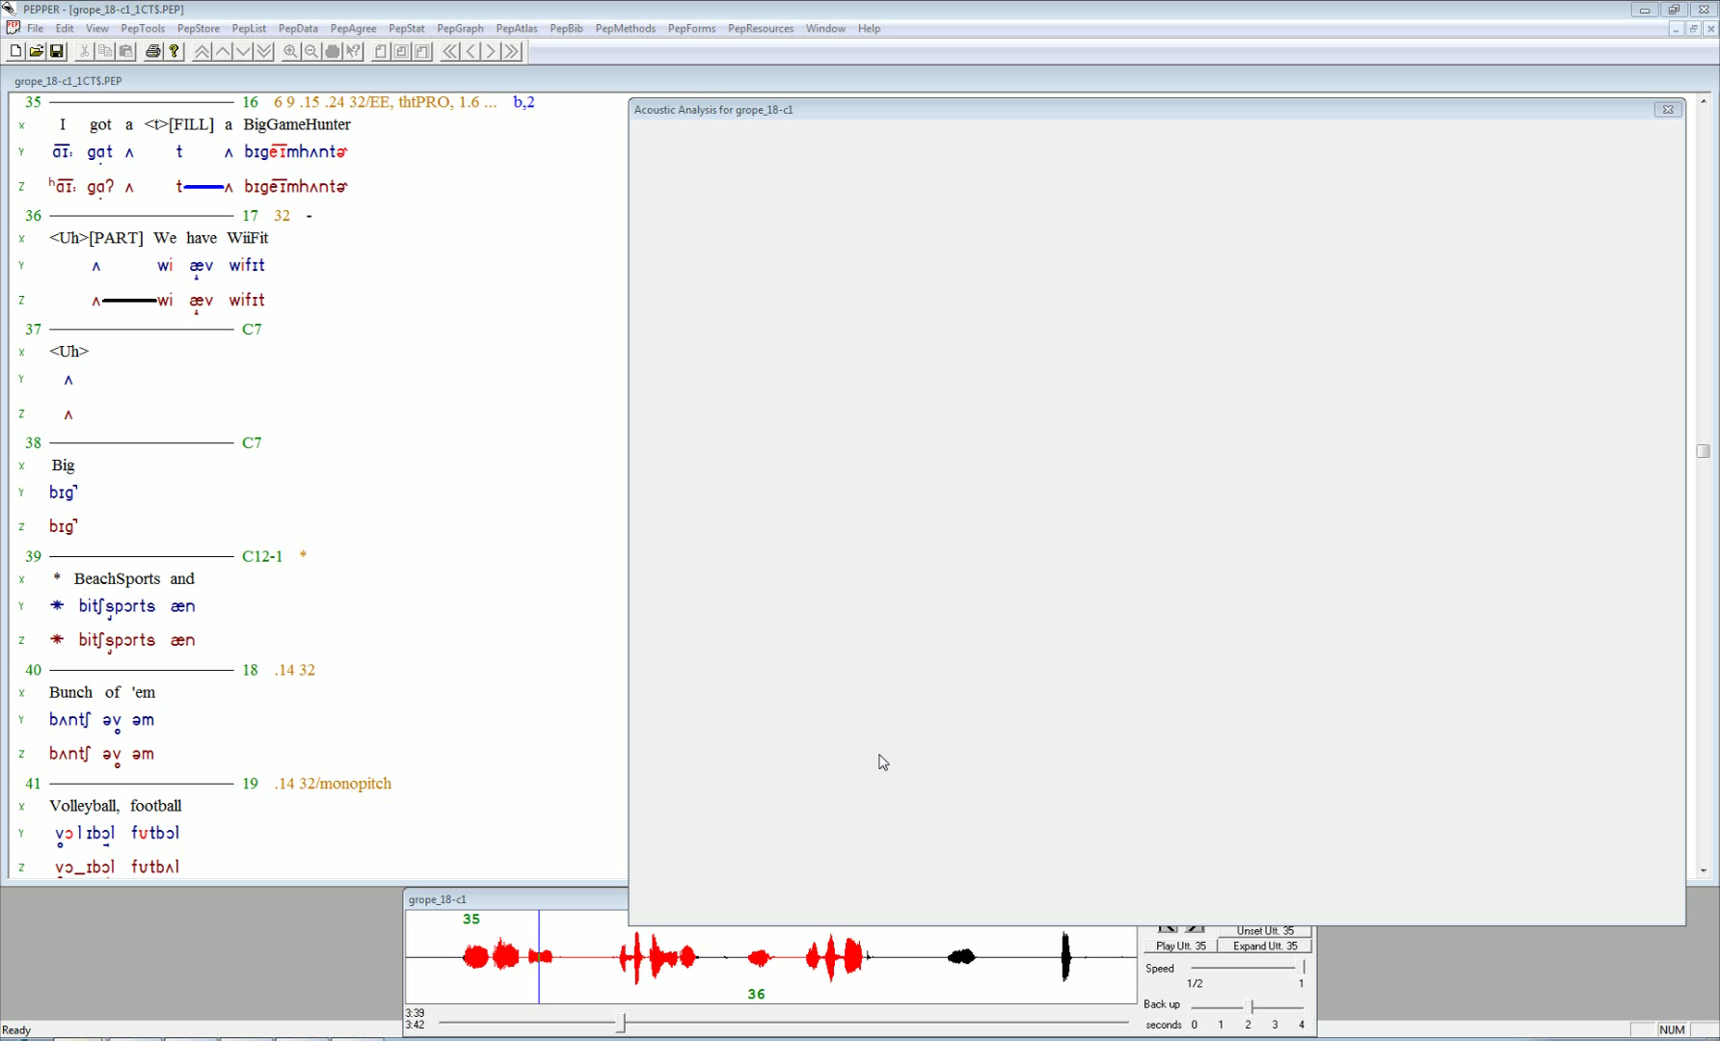
grope_18: 15 year old male. The utterance was glossed as: “I got a <t> a BigGameHunter”
There is one inappropriate pause (lavender) in an inappropriate linguistic unit.
It’s between the words “got” and “a.”
Note the visible spectrographic energy during the pause.
It was transcribed as <t> in the perceptual transcription.
Vowels and select consonants are marked in red.

Slide 26
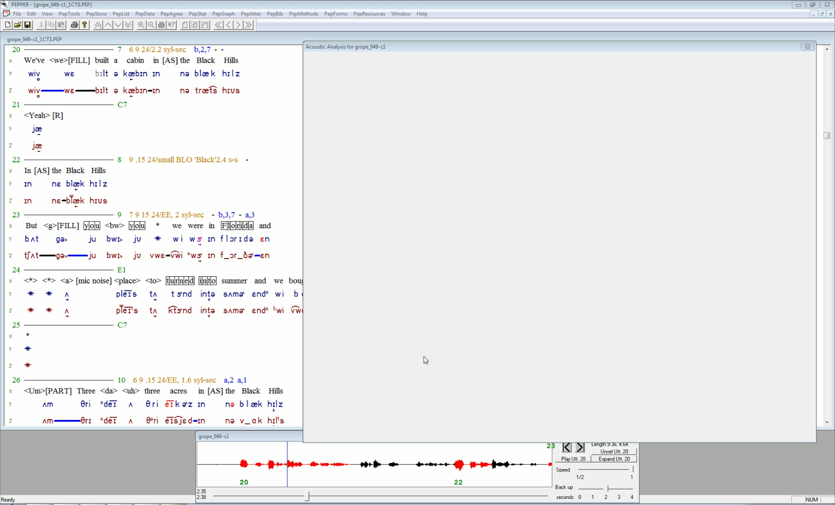
grope_049: 70 year old male. The utterance was glossed as: “We’ve <we> built a cabin in the Black Hills”
There are three pauses in this utterance.
The first pause is an inappropriate pause (lavender) in an inappropriate linguistic unit. It’s between the words “we’ve” and “<we>.
Note the visible spectrographic energy during the pause.
The other two pauses (blue) are appropriate pauses.
Vowels and select consonants are marked in red.

Slide 27
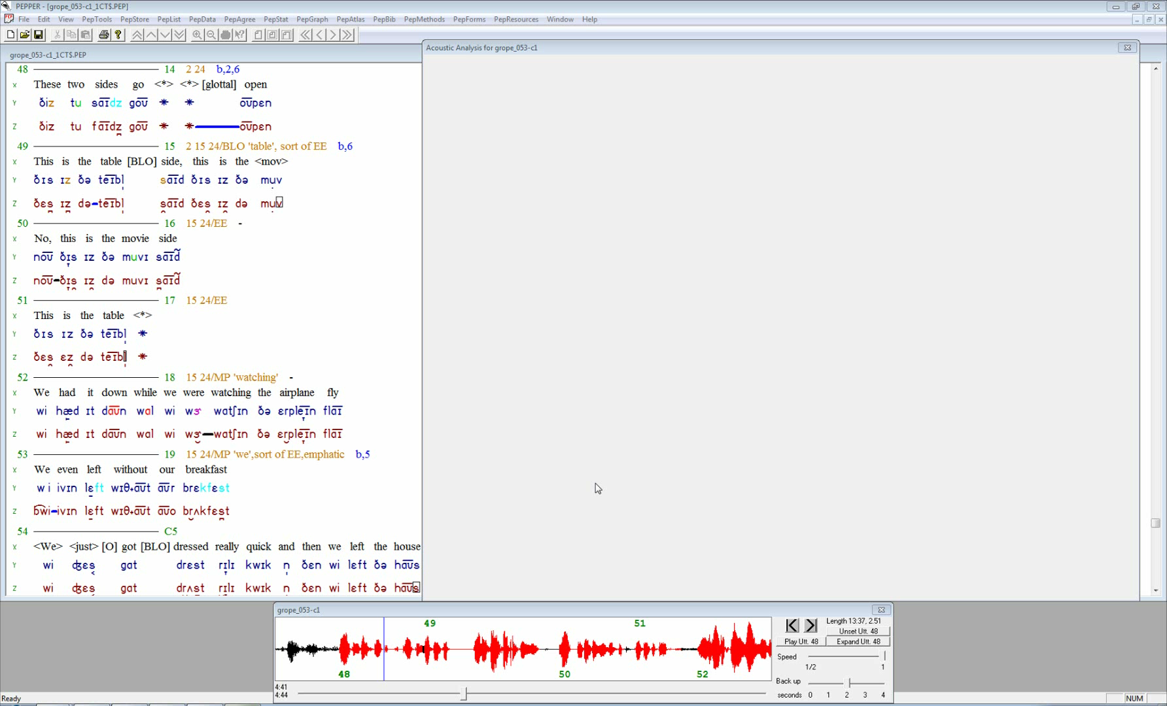
grope_053: 7 year old male. The utterance was glossed as: “These two sides go <*> <*> open”
There is one inappropriate pause (lavender) in an inappropriate linguistic unit in this utterance.
It is between the words “go” and “open.”
Note the spectrographically visible gestures, perceptually transcribed as * * in the utterance.
There is also an abrupt (sudden, loud) onset of glottal pulsing for “open.”
Vowels and select consonants are marked in red.

Slide 28
II. Type II Inappropriate Between-Words Pauses
A. Long

Slide 29
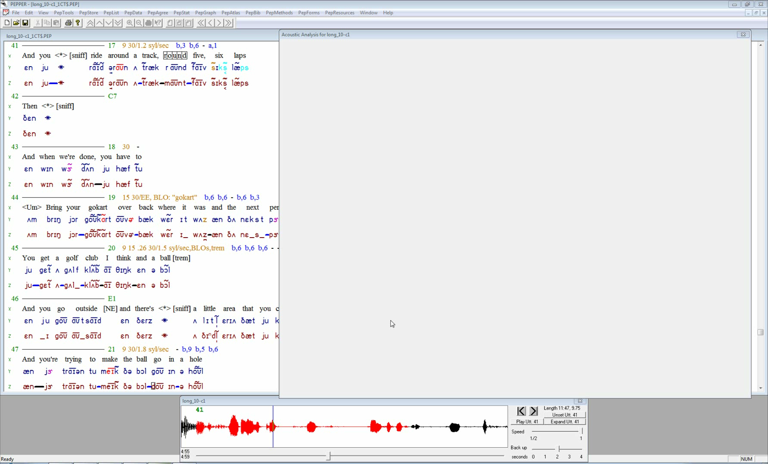
long_10: 11 year old male. The utterance was glossed as: “And you <*> ride around a track, <round> five six laps”
There are four pauses in this utterance.
The last pause (lavender) is an inappropriate pause between the words “<round>” and “five” in an appropriate linguistic unit.
It is a particularly long pause (2500ms).
The first inappropriate pause has a breath, the second inappropriate pause (lavender) is abrupt, and the remaining pause (blue) is appropriate.
Vowels and select consonants are marked in red.

Slide 30
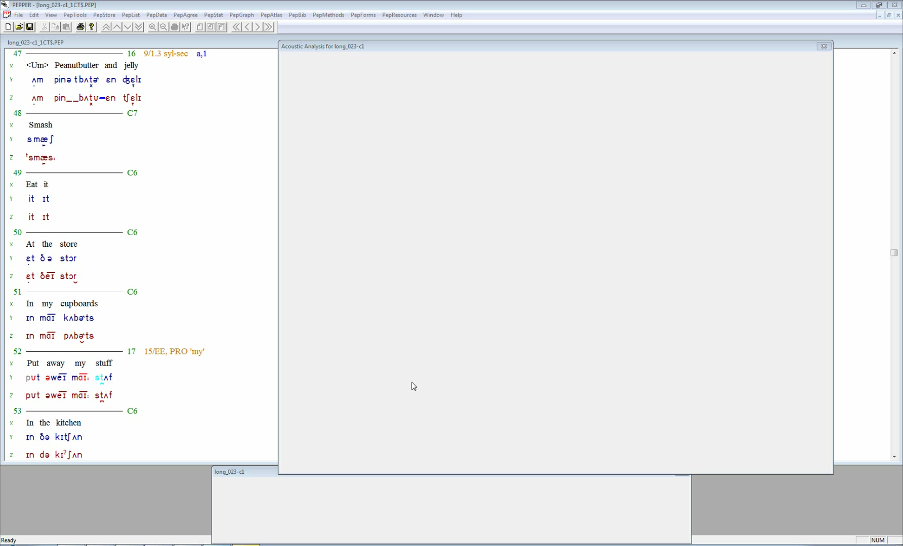
long_023: 12 year old female. The utterance was glossed as: “Peanut butter and jelly”
There is one inappropriate pause (lavender) in an appropriate linguistic unit in this utterance.
It’s between “butter” and “and.”
The long pause is 950ms.
Vowels and select consonants are marked in red.

Slide 31
II. Type II Inappropriate Between-Words Pauses
B. Breath

Slide 32
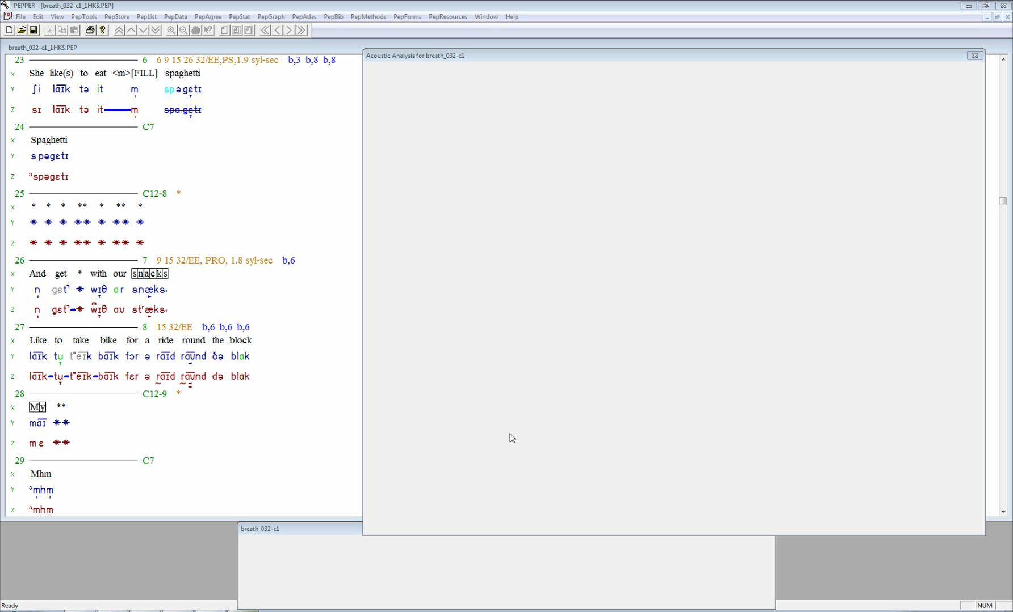
breath_032: 5 year old male. The utterance was glossed as: “She like(s) to eat <m> spaghetti”
There are three inappropriate pauses (lavender) in inappropriate linguistic units in this utterance.
The first pause is between “eat” and “m.”
The energy for a breath is visible during the pause.
The two other pauses are within the word “spaghetti.”
Vowels and select consonants are marked in red.

Slide 33
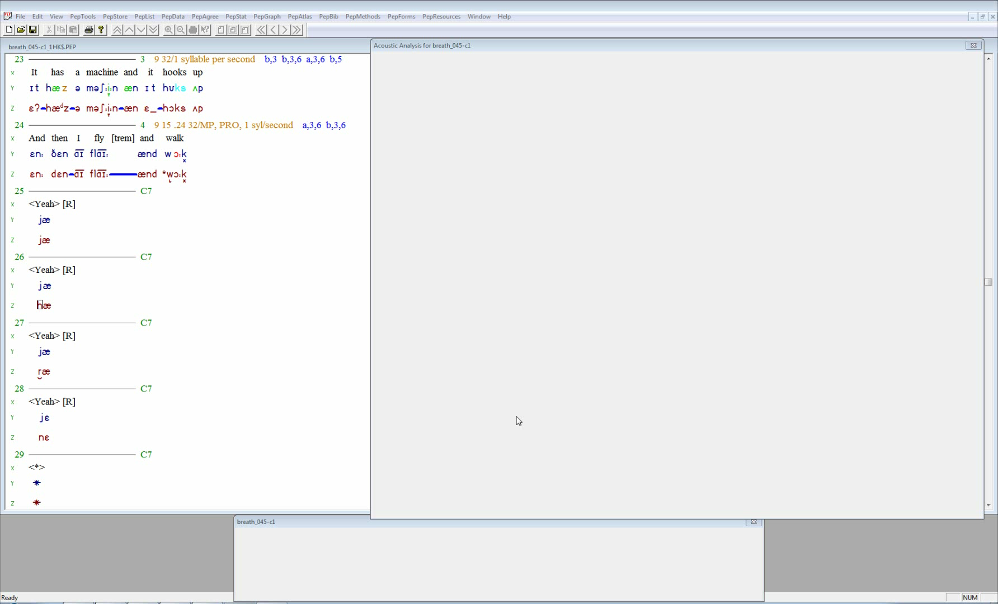
breath_045: 5 year old male. The utterance was glossed as: “It has a machine and it hooks up”
There are 4 inappropriate pauses (lavender in this utterance).
The first two and the final inappropriate pauses are in inappropriate linguistic units, while the third inappropriate pause is in an appropriate linguistic unit.
The first three show energy for a breath during the pause.
The final inappropriate pause is in the proximity of an amplitude change.
Vowels and select consonants are marked in red.

Slide 34
II. Type II Inappropriate Between-Words Pauses
C. Repetitions/Revisions

Slide 35
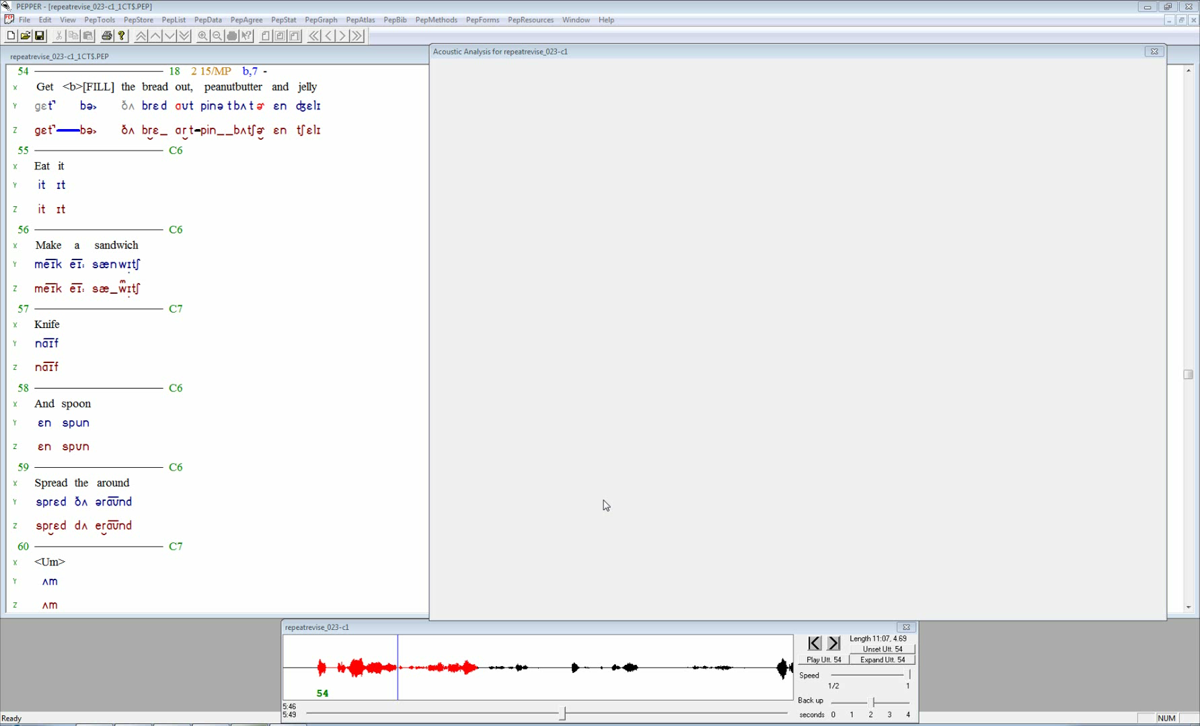
repeatrevise_023: 12 year old female. The utterance was glossed as: “Get <b> the bread out, peanut butter and jelly”
There are two pauses in this utterance.
The first pause is an inappropriate pause (lavender) in an inappropriate linguistic unit. It’s located between “get” and “b.”
Note the added “b” sound, most likely in anticipation of the upcoming word “bread.”
The second pause (blue) is appropriate.
Vowels and select consonants are marked in red.

Slide 36
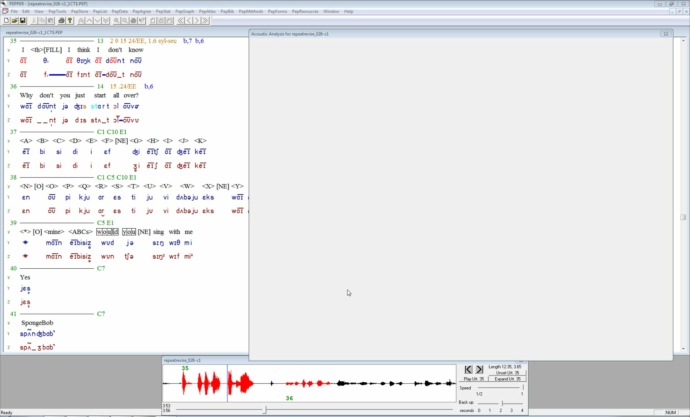
repeatrevise_026: 7 year old male. The utterance was glossed as: “I <th> I think I don’t know”
There are two inappropriate pauses (lavender) in inappropriate linguistic units in this utterance.
The first follows a short sound “th” which is likely related to the upcoming word “think.”
The second pause is an abrupt pause.
Vowels and select consonants are marked in red.

Slide 37
II. Type II Inappropriate Between-Words Pauses
D. Additions

Slide 38
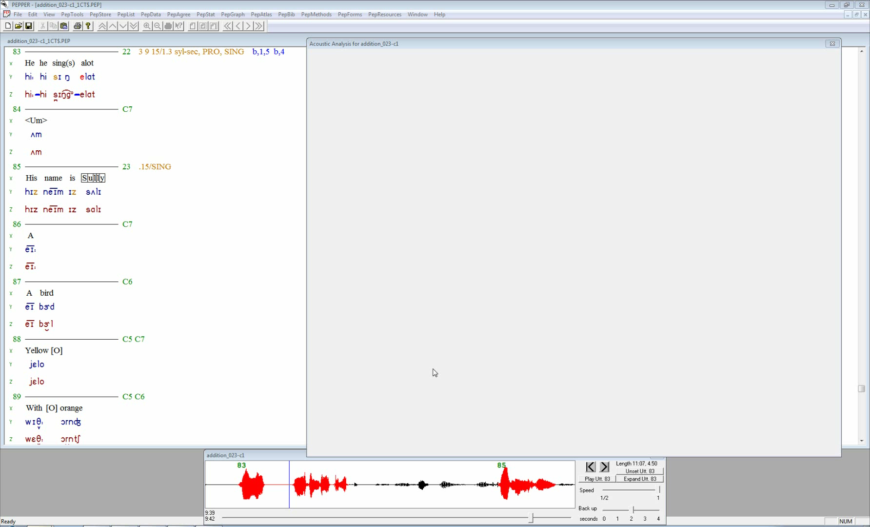
addition_023: 12 year old female. The utterance was glossed as: “He he sing(s) a lot”
There are two inappropriate pauses (lavender) in inappropriate linguistic units in this utterance.
The first inappropriate pause was too long and included an amplitude change.
The second inappropriate pause was preceded by a sound addition (pink).
Vowels and select consonants are marked in red.

Slide 39
III. “Voicer” exemplar

Slide 40
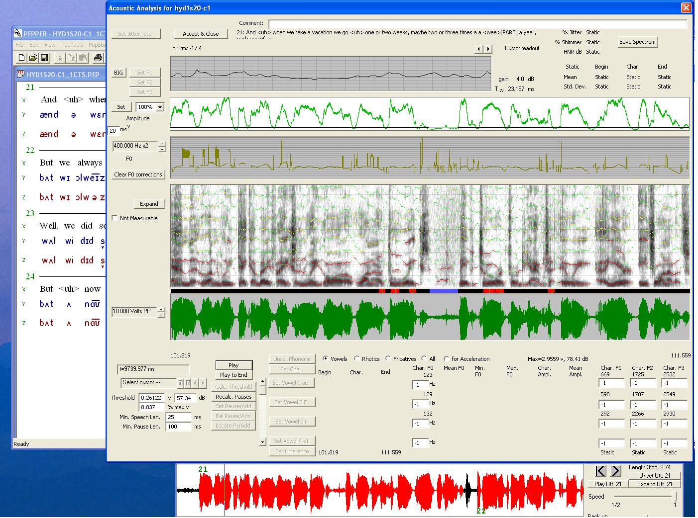
Framework
Preliminaries
Method
Findings
Conclusions

